Slide 1
Introduction to Computer Vision with OpenCV

Slide 2
Outline
Introduction to Computer Vision
Definition of Computer Vision and its applications
Overview of techniques being used in Computer Vision
Installing Python and External Packages
How to install Python and Python IDE
Introduction to pip for installing external packages
Introduction to OpenCV and NumPy
What is OpenCV and its uses
Installing OpenCV
Reading, displaying, and saving images using OpenCV
How OpenCV uses NumPy arrays for image processing
Basics of Images
Definition of digital images
Image size
Types of images (binary, grayscale, color)
Image file formats (JPEG, PNG, BMP)
Coding Examples
Reading and displaying an image using OpenCV
Basic image manipulation using NumPy (converting to grayscale, resizing, cropping, rotation)
Image filtering using NumPy (blurring, sharpening)
Drawing shapes and text on images using OpenCV
Object detection using OpenCV (such as face detection)

Slide 3
Outline
6. Python
7. NumPy
8. 3D Body Pose Estimation
Introducing mediapipe
3D Pose Estimation on Single Images
3D Pose Estimation on Video frames
Saving results from 3D Pose Estimation on Video frames
3D Pose Estimation on Real-time data (Camera)
3D Hand Pose Estimation
OpenPose
9. Anaconda and Miniconda

Slide 4
Definition and Overview

Slide 5
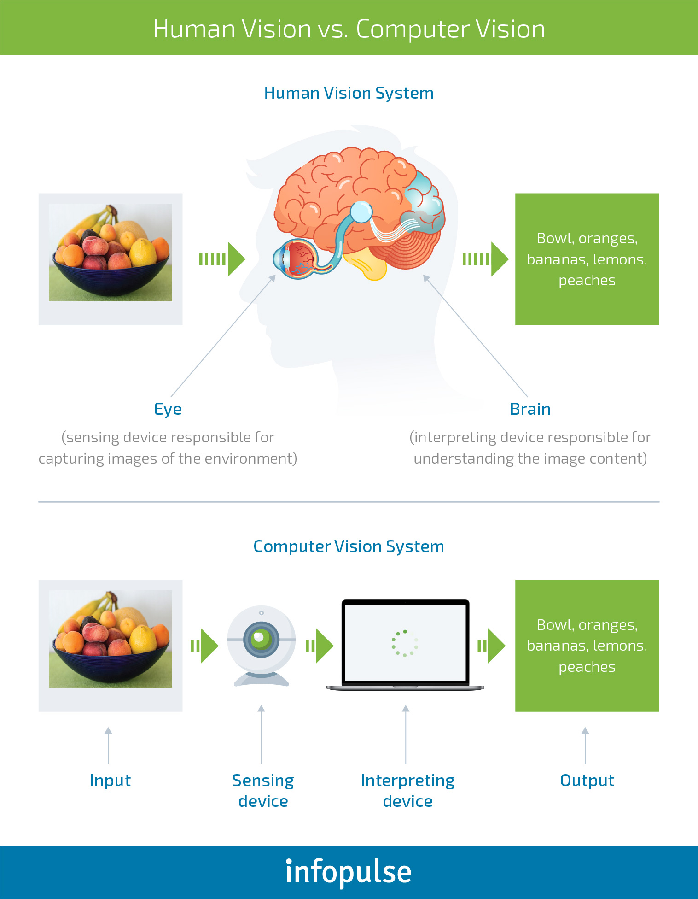
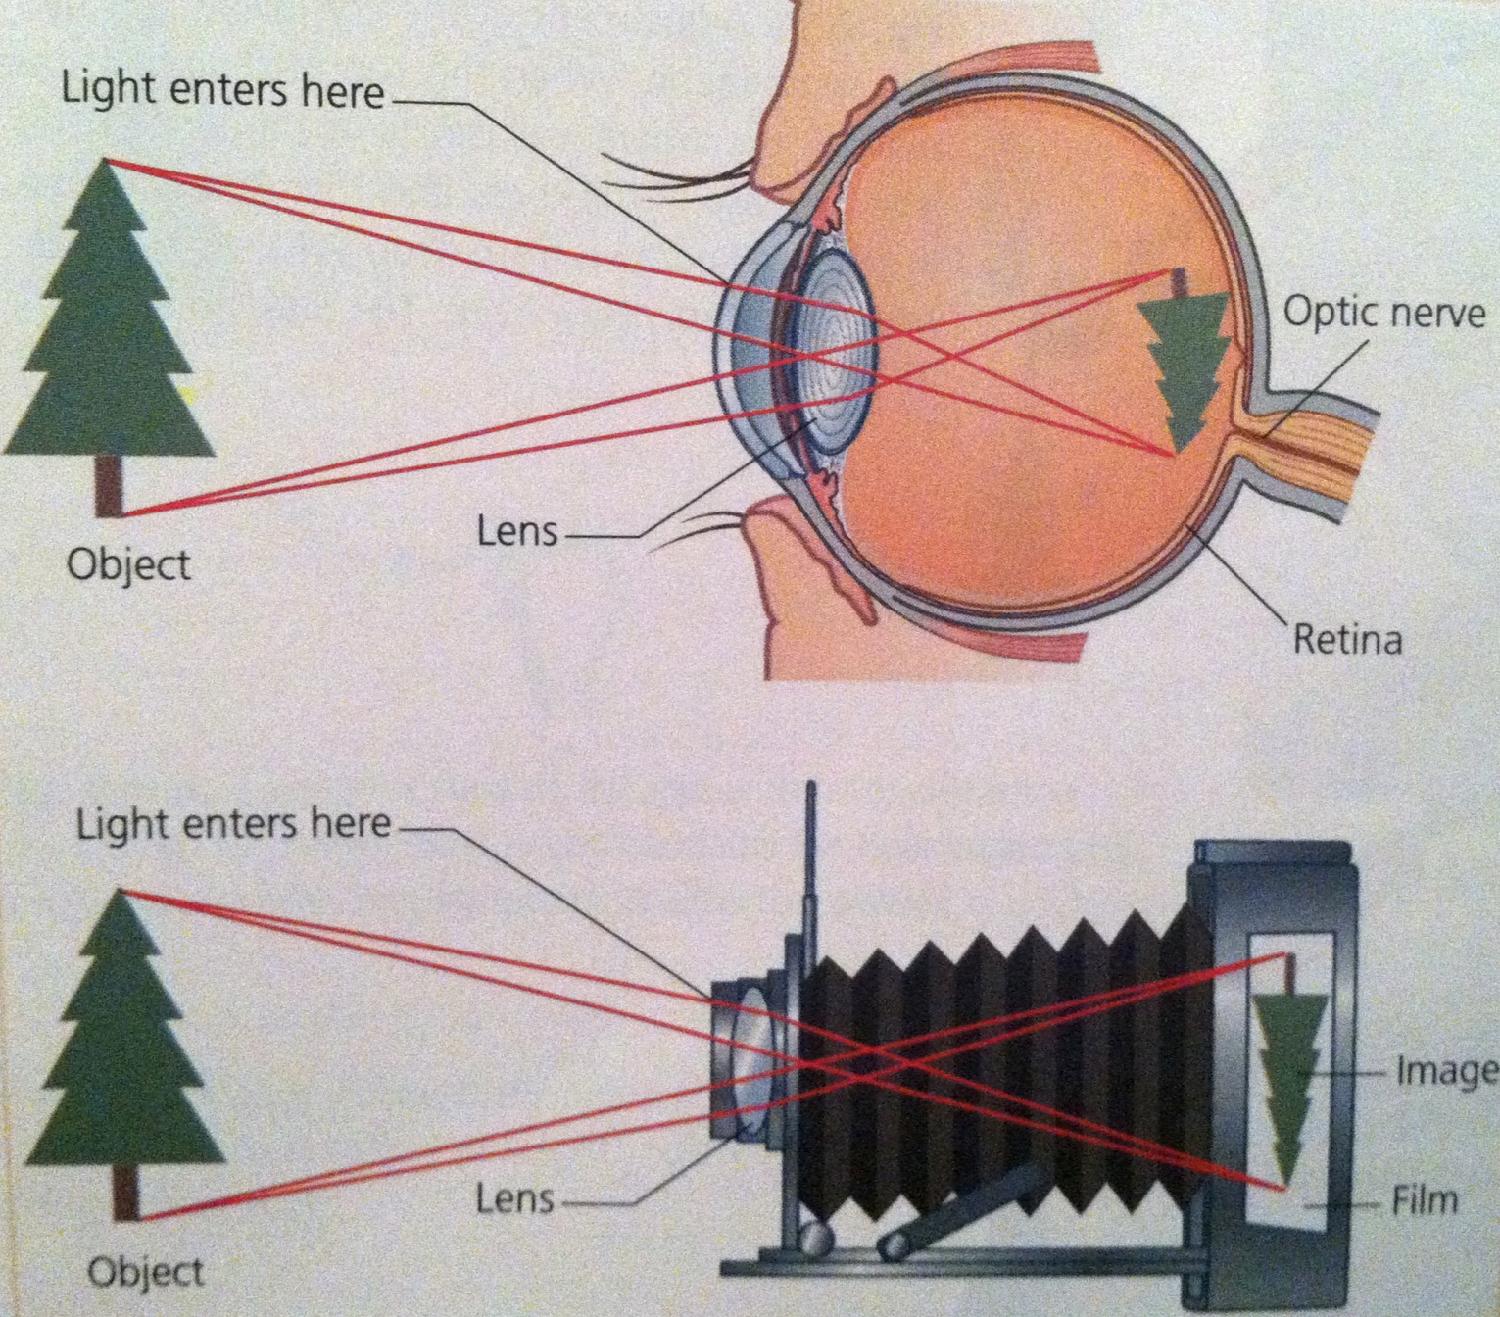

Slide 6
What is Computer Vision
Computer Vision is a field of artificial intelligence that enables computers to understand and analyze images and videos, with the goal of automating tasks that would normally require human visual perception.
It involves the development of algorithms and techniques that enable computers to extract meaningful information from images and videos.

Slide 7
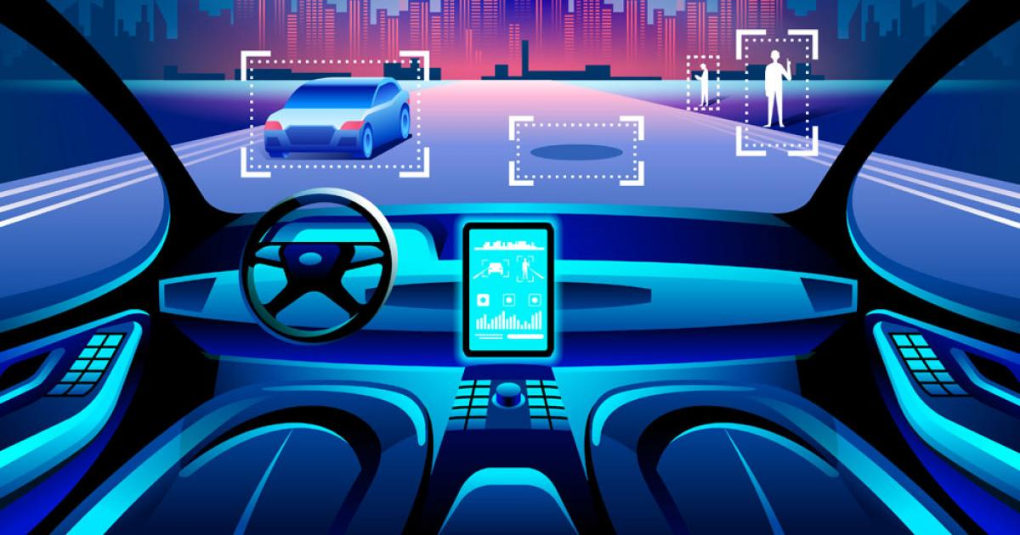
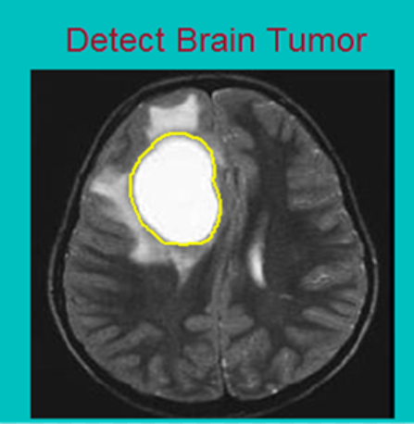
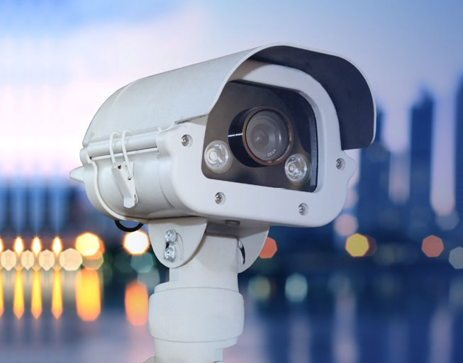
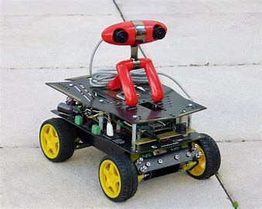
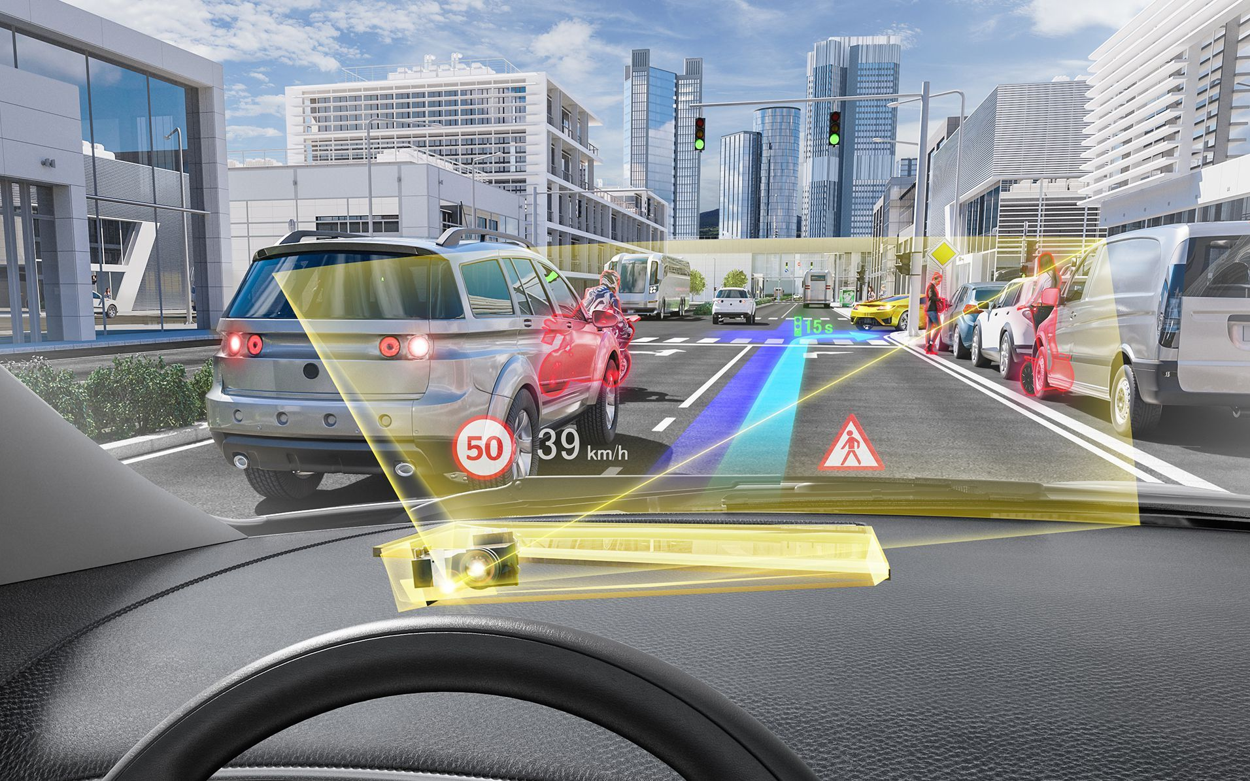
Applications
Autonomous Vehicles
Medical Image analysis
Security and Surveillance
Robotics
Augmented Reality
Quality Control

Slide 8
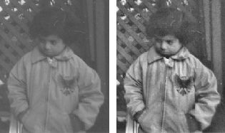
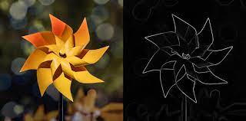
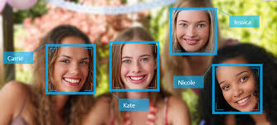
Computer Vision techniques can be classified into…
Traditional techniques: (Today we will cover a little bit of it)
Mostly rely on hand-crafted algorithms (features that are manually extracted for example number of red pixels) and simple machine learning algorithms (clustering, regression, decision tree ,...) that may not be able to handle variations in data.
Some important techniques:
Image Filtering: Techniques used to filter or enhance images, such as smoothing or sharpening filters.
Edge Detection: Techniques used to detect edges or boundaries in images.
Object Detection: Techniques used to detect objects (for example faces) in images, such as, Haar cascades classifier.
Deep learning-based techniques:
The more the data the better the results

Slide 9
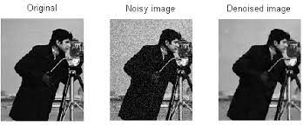
Computer Vision techniques
It is important to note that these techniques can be combined in various ways to solve different computer vision tasks.
For example, we almost never start training a deep learning model without first preparing the data, as this can significantly affect the final results.
Image denoising is one of the most important preprocessing tasks in deep learning, and traditional techniques can be helpful in achieving this

Slide 10
Installing Python and External Packages

Slide 11
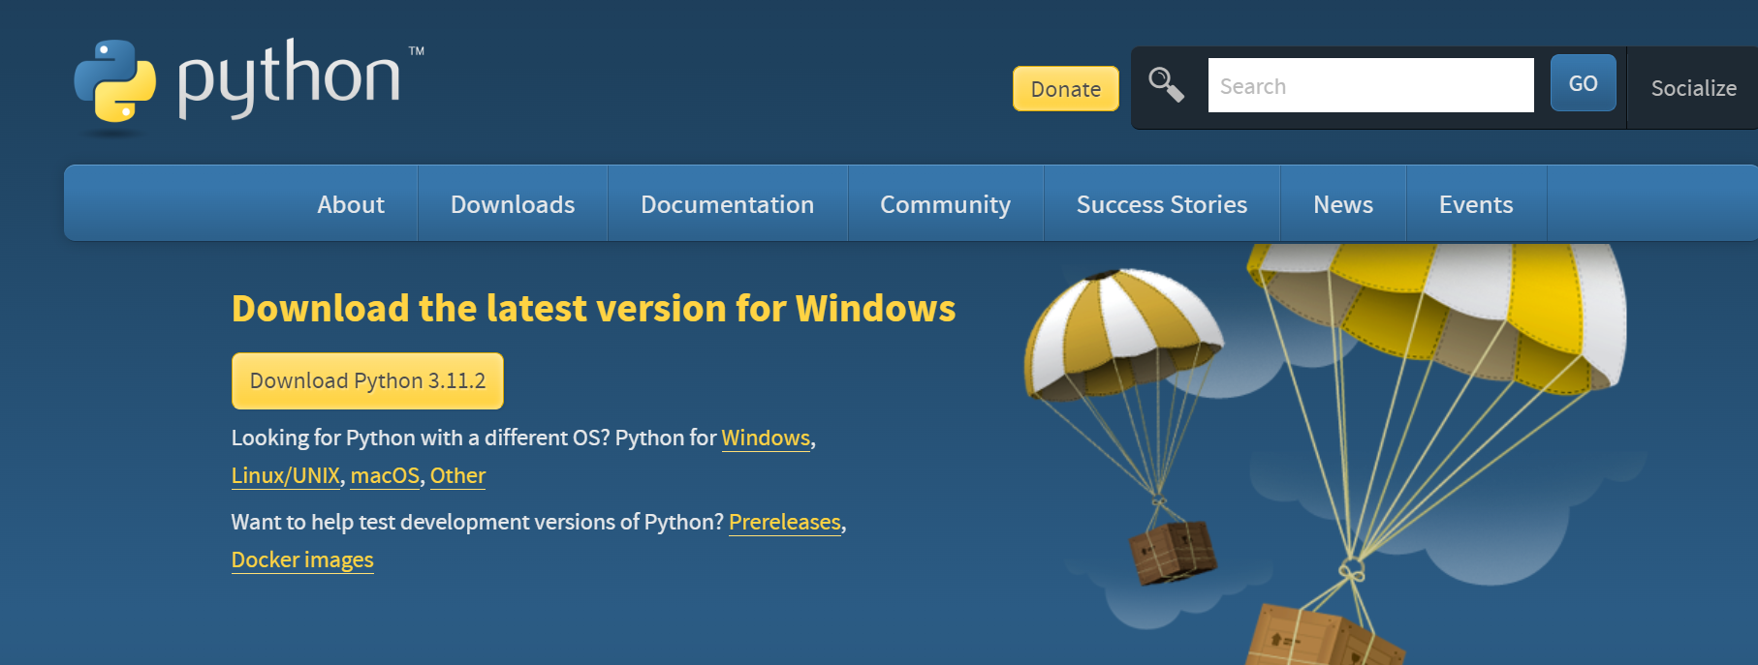
Downloading Python
Link: https://www.python.org/downloads/

Slide 12
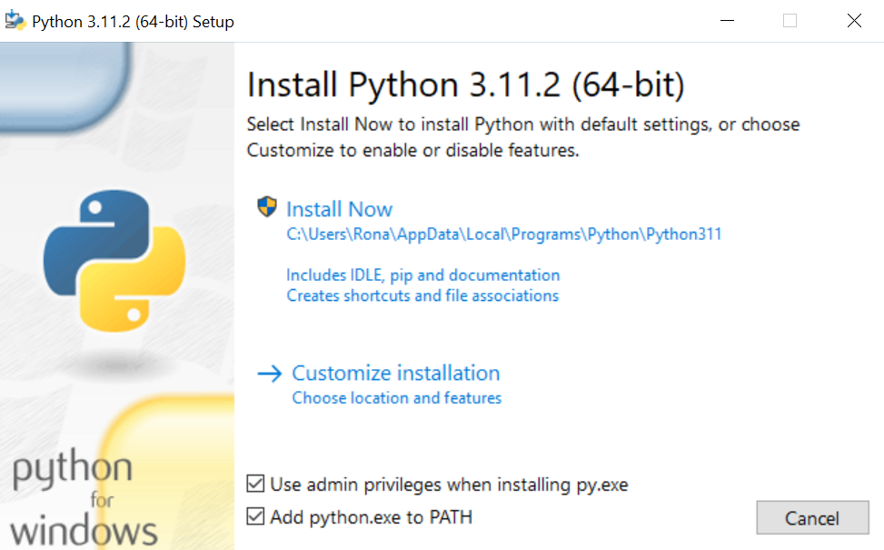
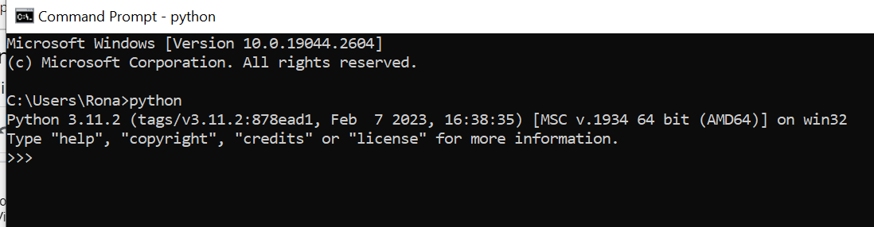
Installing Python
Note: Don’t forget to add python PATH to the environment variable while installing python
Successful installation

Slide 13
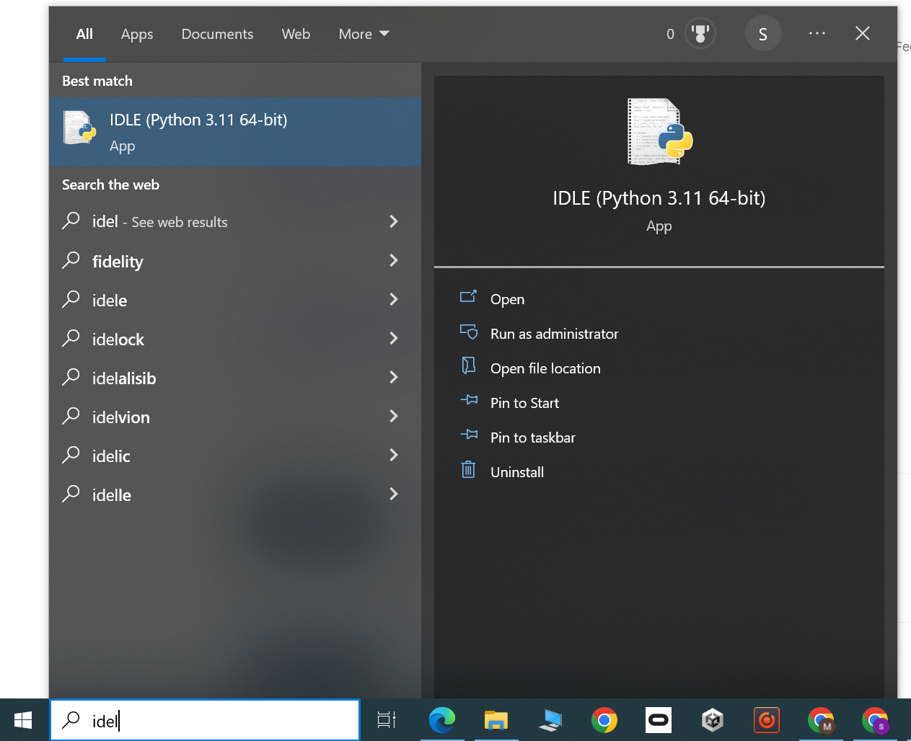
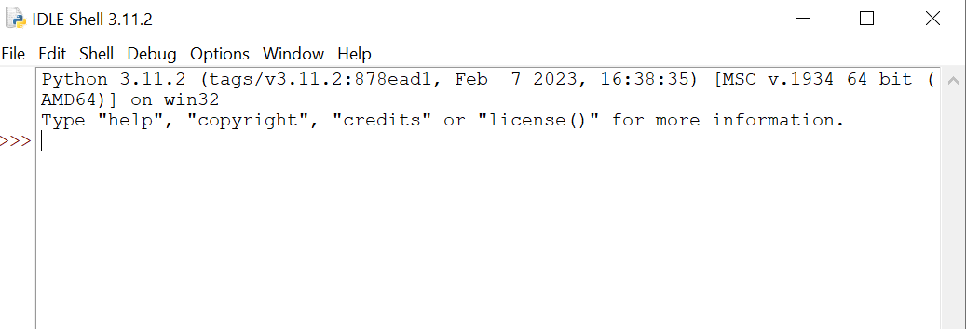
Python IDLE
IDLE is an integrated development environment for Python which will be installed alongside python

Slide 14
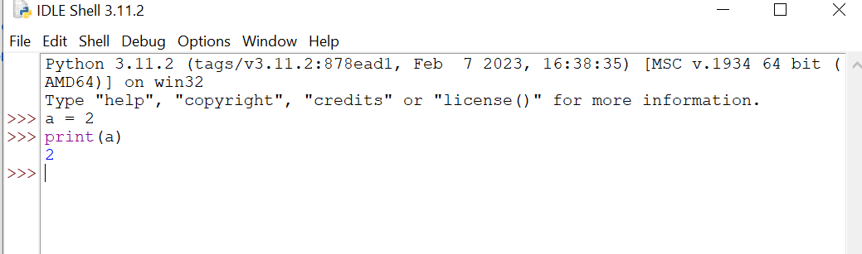
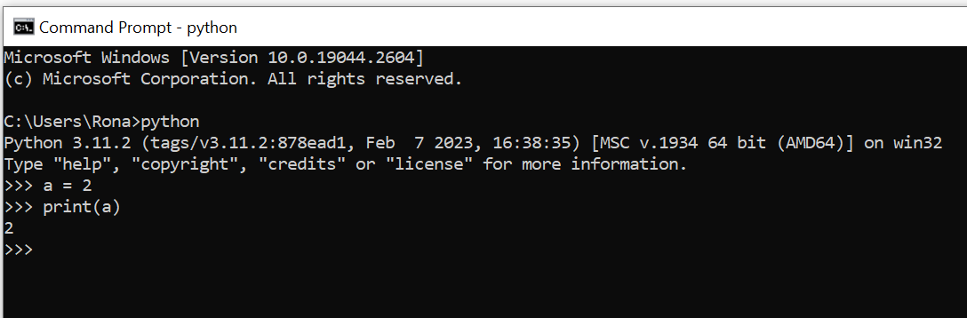
IPython coding
Interactive Python
Running codes line by line
In IDLE
In CMD

Slide 15
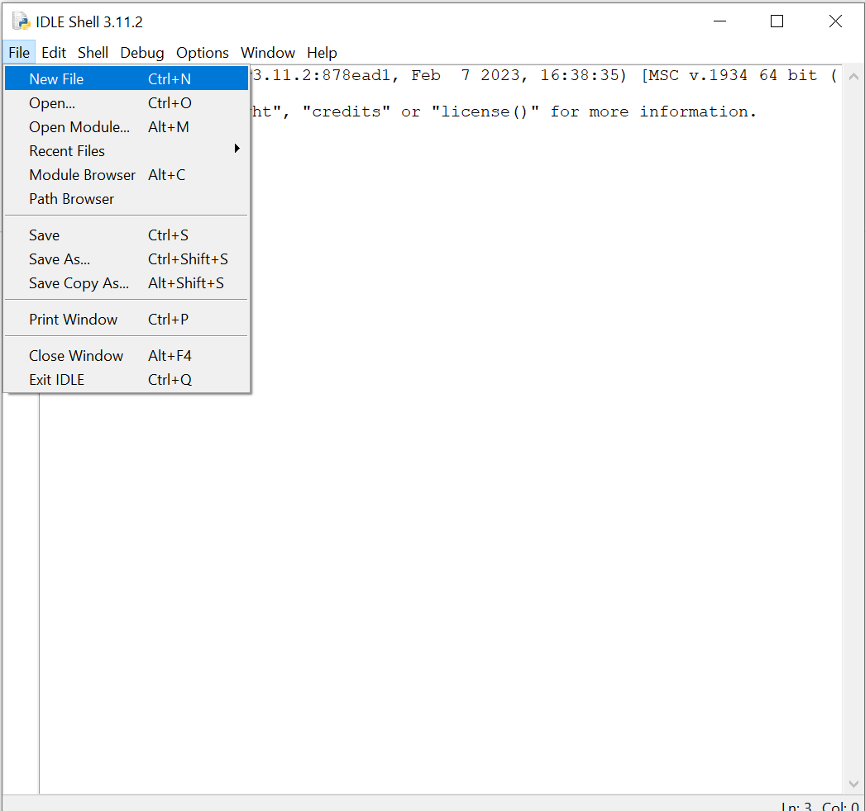
Running python codes as a “.py” file
Create a python file

Slide 16
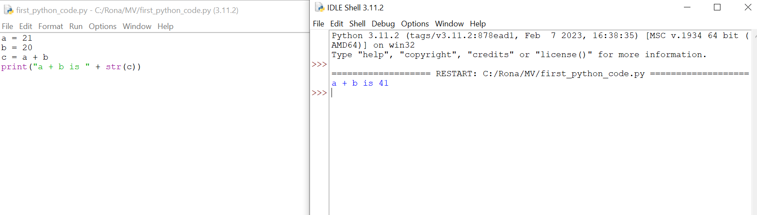
Running python codes as a “.py” file
Press F5 to run the code

Slide 17
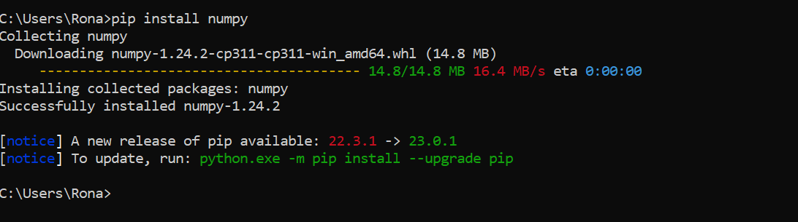
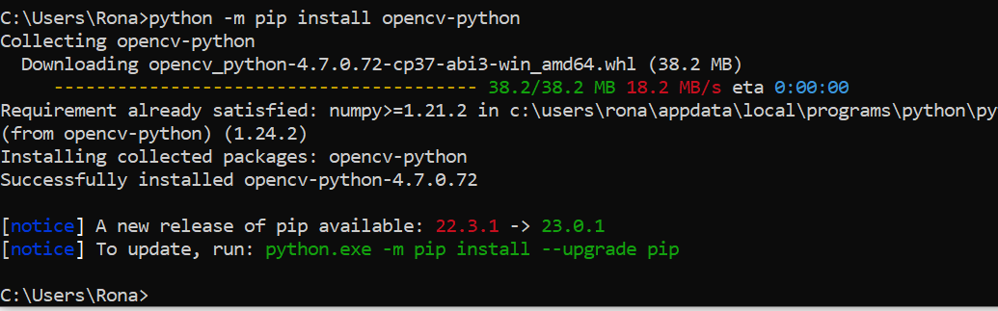
Installing python packages
pip install “package name” Or python -m pip install “package name”
Example:

Slide 18
Introduction to OpenCV and NumPy

Slide 19
What is OpenCV
OpenCV (Open Source Computer Vision Library) is an open-source computer vision and machine learning software library.
// scikit-image
It is a set of programming functions and algorithms that developers can use to perform various tasks related to image and video processing,
These tasks includes object detection and recognition, facial recognition, motion tracking, and more.
Installing : pip install opencv-python

Slide 20
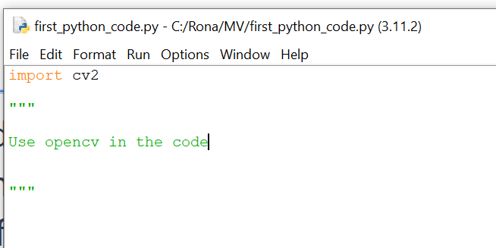
Using opencv
To use external packages in python, we should import them in the code by adding Import “package name” in the code before using that package in the code (mostly on the top of the code)
The package name while importing maybe different from what we use for installing
Example:
Installing opencv: pip install opencv-python
Importing opencv in the code: import cv2

Slide 21
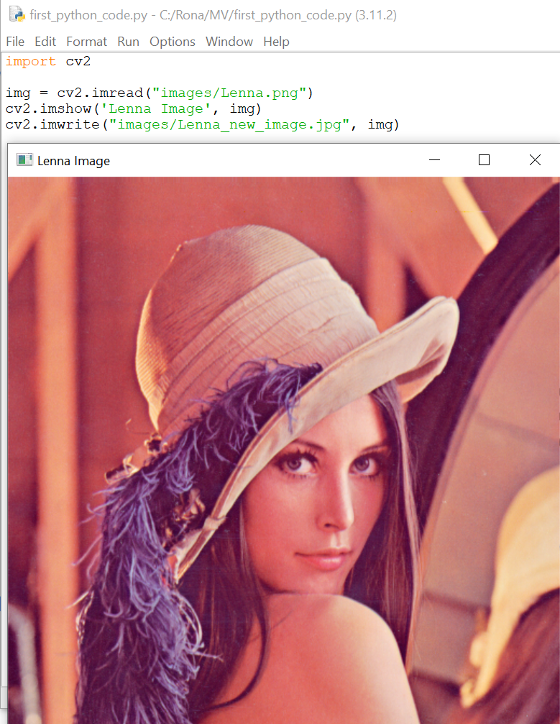
Basic opencv functions
Reading images
image-variable = cv2.imread("Path to image")
ex) img = cv2.imread("images/Lenna.png")
Displaying images
cv2.imshow('window title', image-variable)
ex) cv2.imshow('Lenna Image', img)
Saving images
cv2.imwrite('new_image path and format', new-image-variable)
ex) cv2.imwrite("images/Lenna_new_image.jpg", img)

Slide 22
What is NumPy?
NumPy is a Python library that provides support for…
Large, multi-dimensional arrays and matrices,
A large collection of mathematical functions to operate on them.
NumPy is widely used in…
Scientific computing
Data analysis
Machine Learning

Slide 23
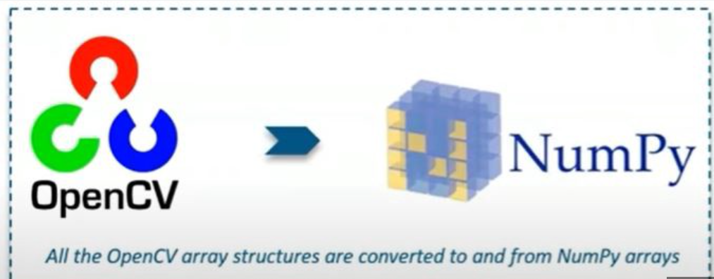
Why we need NumPy in opencv?
In OpenCV, NumPy is used to
represent images and matrices
perform various image processing operations
NOTE: NumPy arrays are the primary data structure used for representing images in OpenCV.

Slide 24
Why we need NumPy in opencv?
When you read an image using OpenCV in Python, it is loaded as a NumPy array.
You can manipulate and process this array using NumPy functions and operations.
For example, you can use NumPy to crop or resize an image, as well as to perform mathematical operations such as addition or subtraction.

Slide 25
Basics of Images

Slide 26
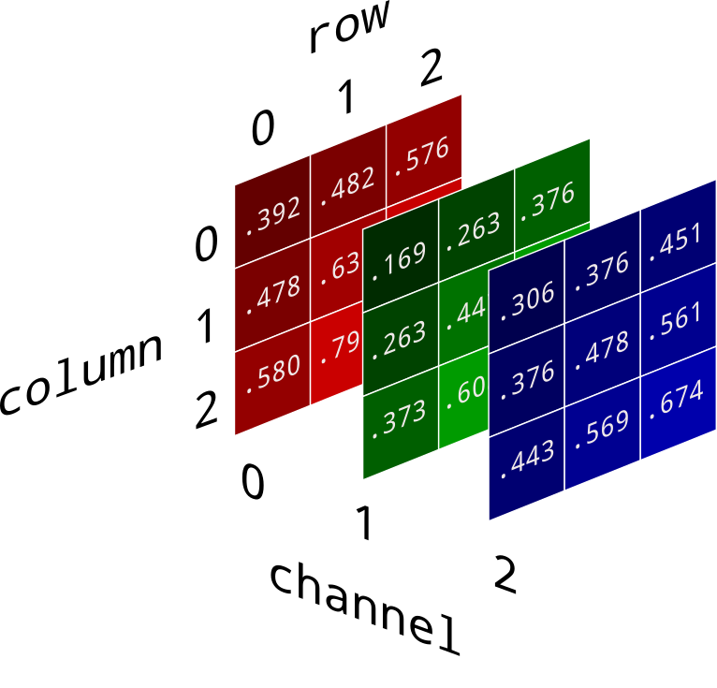
Definition of digital images in numpy
In OpenCV, NumPy arrays are commonly used to define digital images.
A NumPy array is a collection of values that can be thought of as a table with rows and columns.
In the case of digital images, a NumPy array can be used to represent the pixel values of an image.
Pixel values are numerical values that represent the color (and brightness) of a specific pixel in a digital image.
For example in RGB (Red, Green, Blue) images each pixel consists of 3 values.
each of this values can be in (0,255) range.
Blue: (0,0,255)

Slide 27
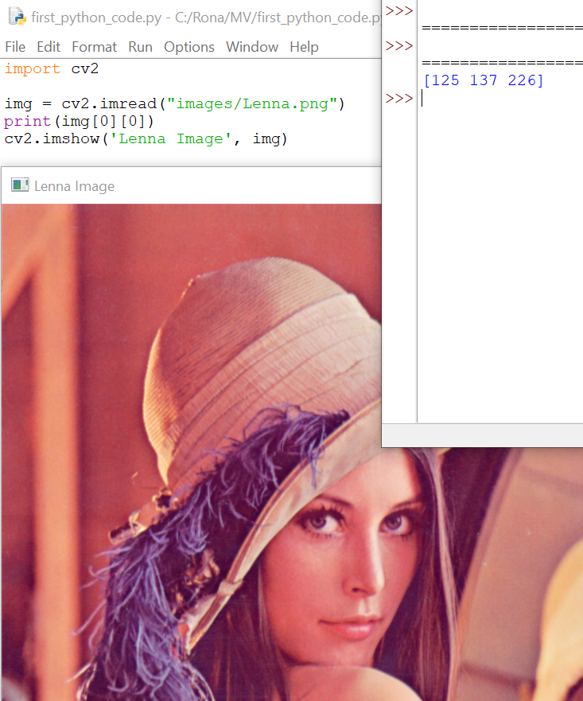
Pixel values in opencv
Pixel value can be accessed by indexing
For example: img[0][0]
B channel = 125
G channel= 137
R channel= 226
Note: opencv uses BGR instead of RGB

Slide 28
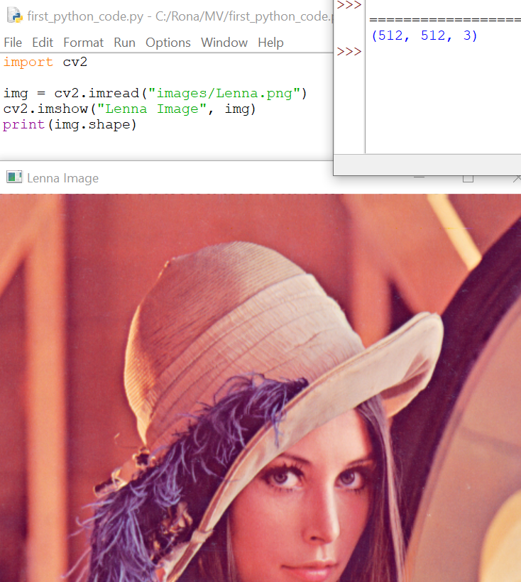
Image size
Image size refers to the physical dimensions of an image, such as its height and width, usually measured in inches, centimeters, or pixels.
In OpenCV image size is measured in pixels.
We can find out the image size using “shape” which is a numpy array command.
Result can be interpreted as : (height, width, channel)
Ex) print(img.shape) —-> result: (512, 512, 3)

Slide 29
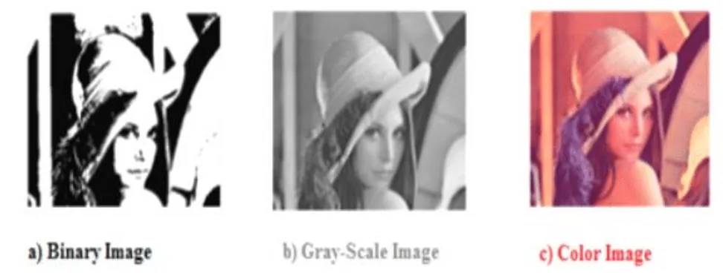
Types of images (binary, grayscale, color)
In OpenCV, there are three main types of images based on the number of color channels they contain.

Slide 30
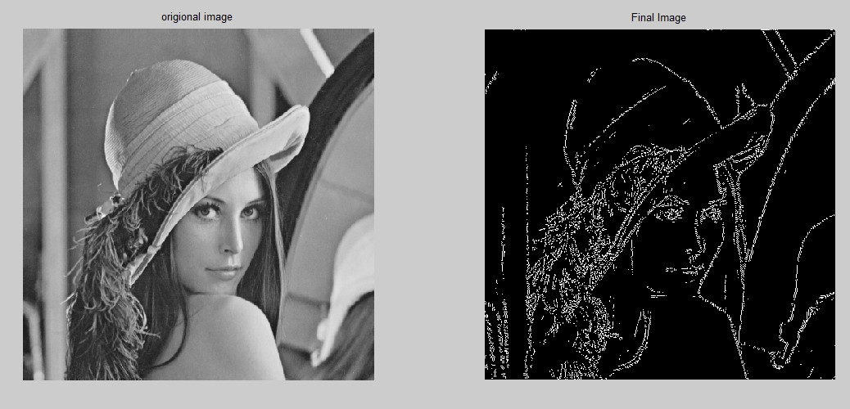
Binary Images
They have only two pixel values, usually black and white,
They are used for simple image processing tasks (such as edge detection)
In OpenCV, binary images are represented as single-channel grayscale images, where each pixel is either black (0) or white (255).
An edge refers to a sudden change between neighboring pixels in an image.

Slide 31
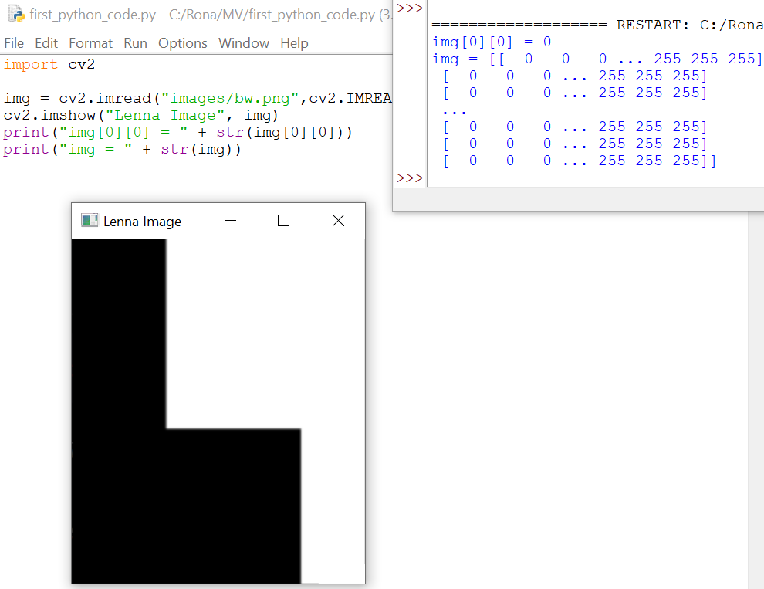
Binary Images
NOTE: The numpy array is 2D

Slide 32
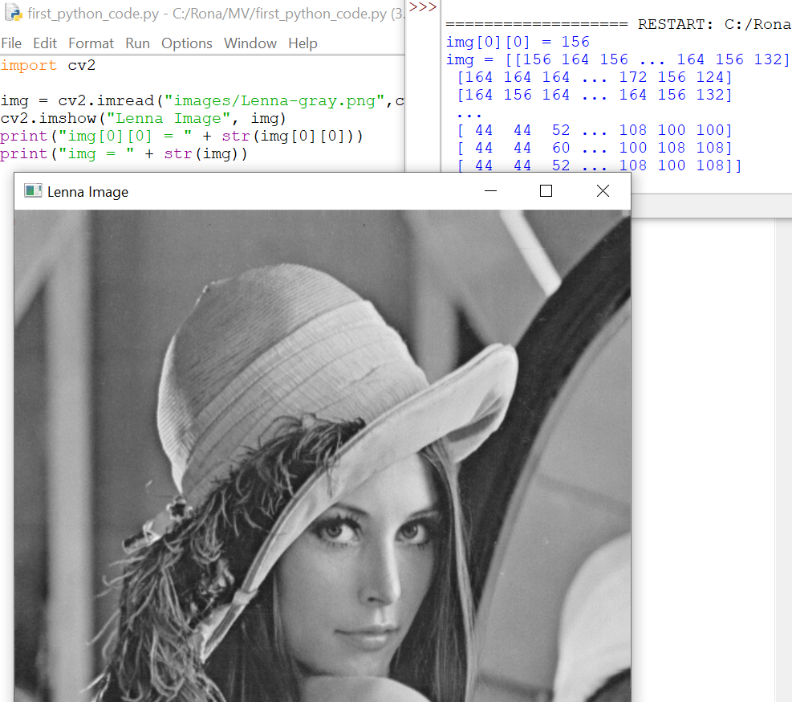
Grayscale Images
Images that contain a single channel representing the value of each pixel.
In OpenCV, grayscale images are represented as single-channel images, where each pixel value can be from 0 (black) to 255 (white).
NOTE: The numpy array is 2D.

Slide 33
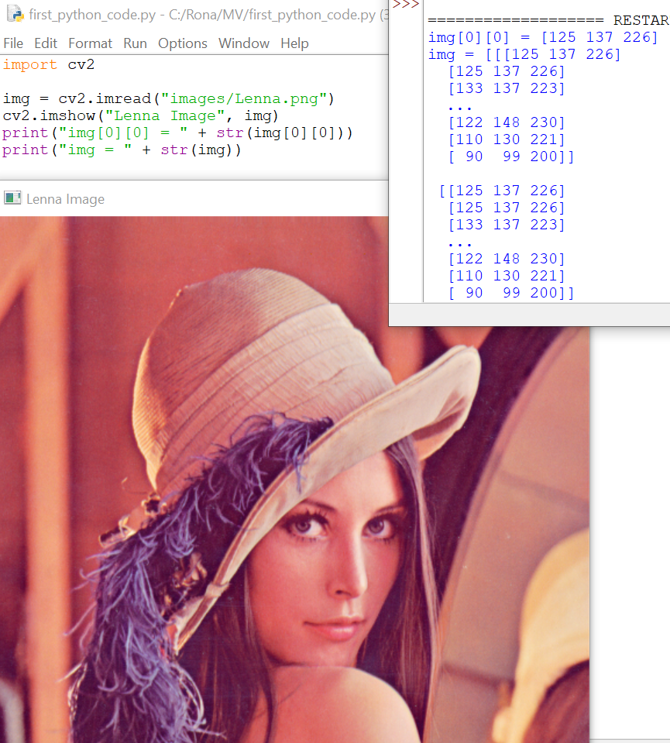
Color Images
Color images are images that contain three color channels, usually red, green, and blue (RGB), or hue, saturation, and value (HSV),and are used to represent the color of each pixel.
In OpenCV, color images are represented as three-channel images, where each pixel has three values each color channel.
NOTE: The numpy array is 3D
Each pixel value has 3 values for color channels.

Slide 34
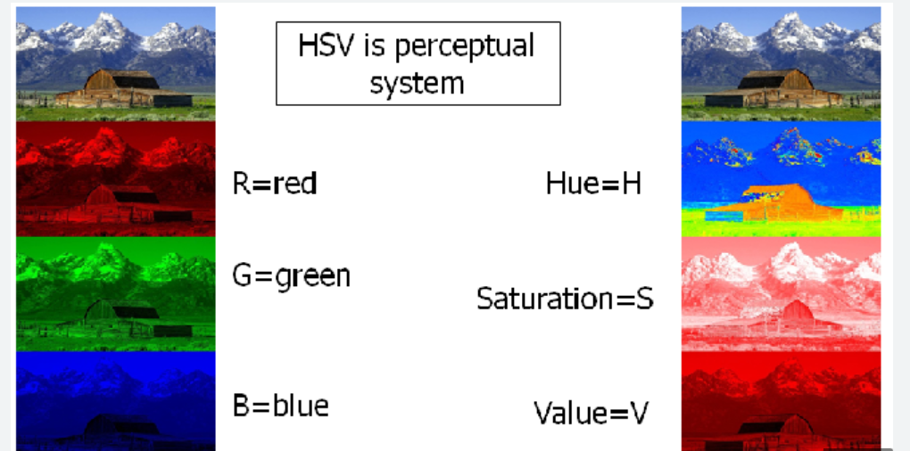
Color Images
We have different Color spaces that RGB is only one of them.
In image processing we mostly use RGB.

Slide 35
Image file formats
OpenCV supports a variety of image file formats (to read and write), including:
JPG/JPEG
PNG
BMP
….

Slide 36
Coding Examples

Slide 37

Reading and displaying images
cv2.imread(“image path”, load-format)
cv2.IMREAD_COLOR → load in color format and do not care about real format of the image
cv2.IMREAD_GRAYSCALE → load in color format and do not care about real format of the image
cv2.IMREAD_UNCHANGED → load the image with its real format

Slide 38
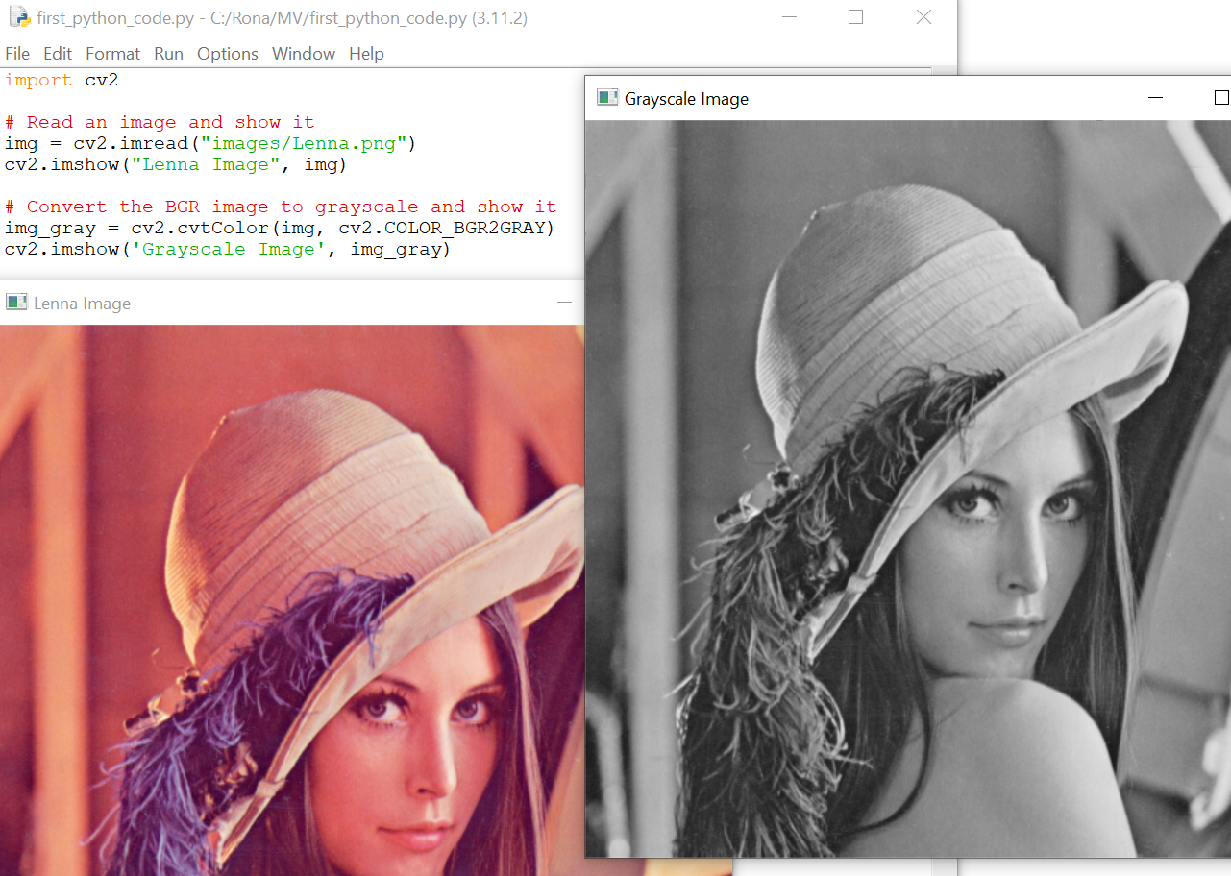
Basic image manipulation
Converting RGB(BGR) image to grayscale
The default image format in opencv is BGR
We can convert RGB to BGR as well

Slide 39
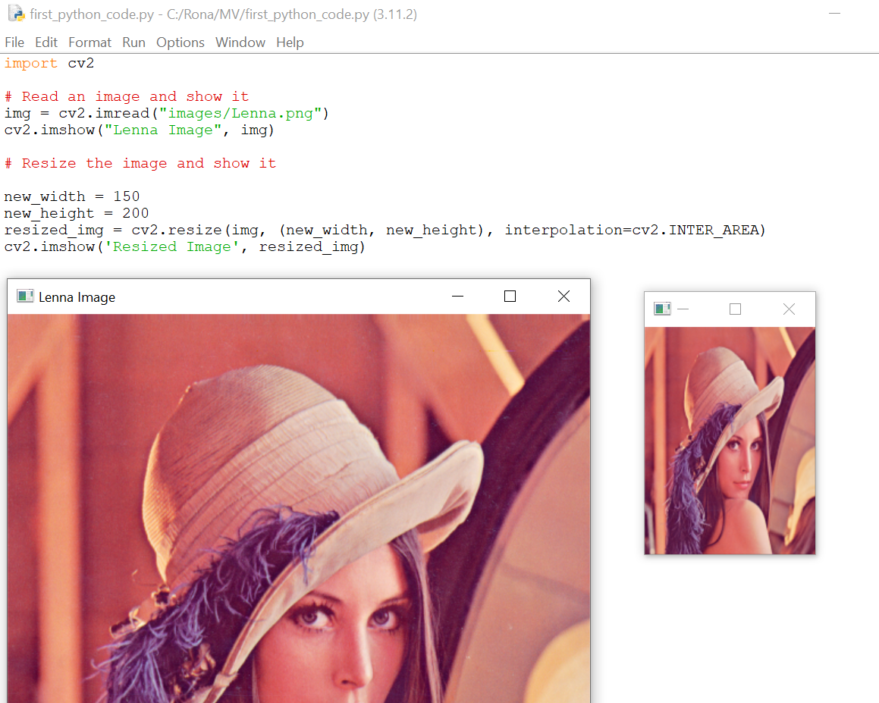
Basic image manipulation
Resizing

Slide 40
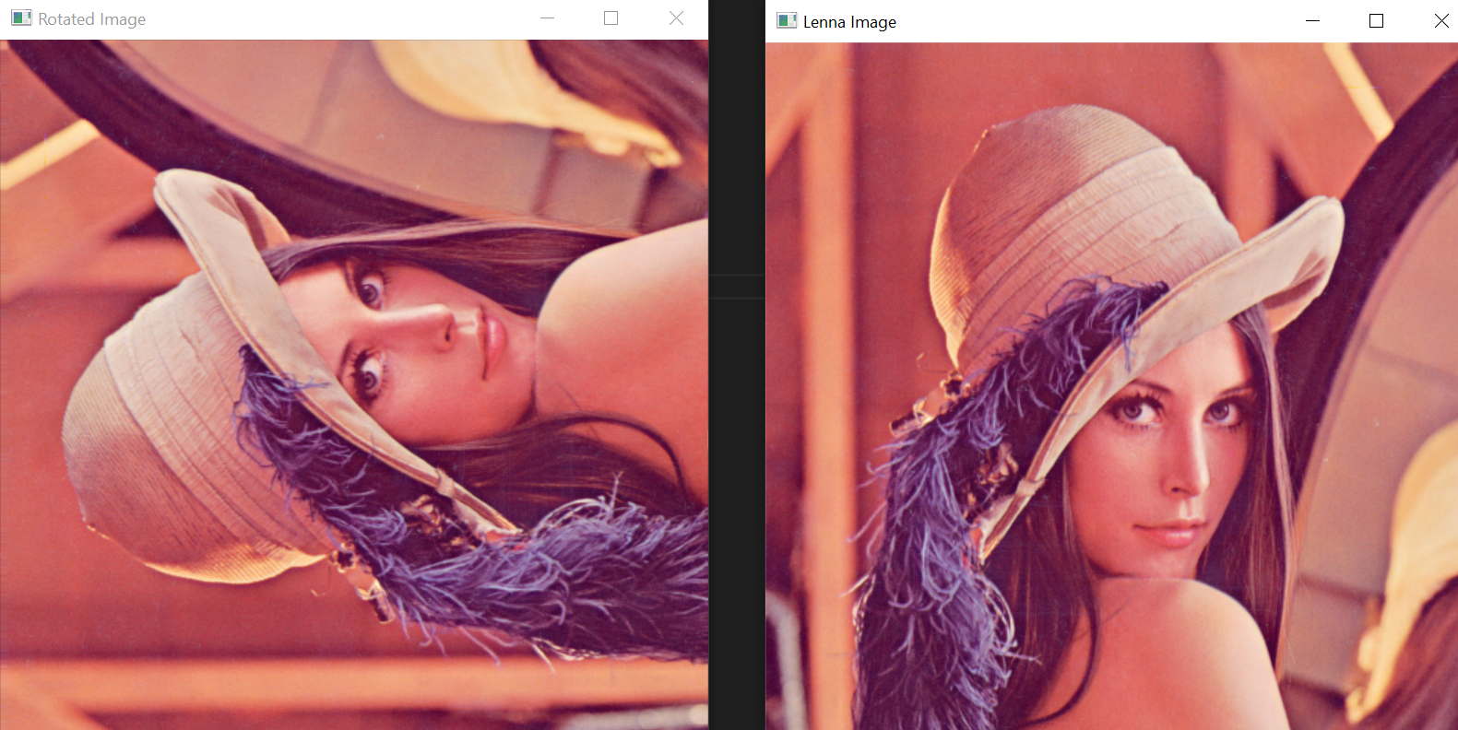
Basic image manipulation
import cv2
# Read an image and show it
img = cv2.imread("images/Lenna.png")
cv2.imshow("Lenna Image", img)
# Rotate the image
img = cv2.rotate(img, cv2.ROTATE_90_COUNTERCLOCKWISE)
cv2.imshow("Rotated Image", img)
cv2.waitKey(0)
Rotation
cv2.ROTATE_90_CLOCKWISE
cv2.ROTATE_180
cv2.ROTATE_90_CLOCKWISE

Slide 41
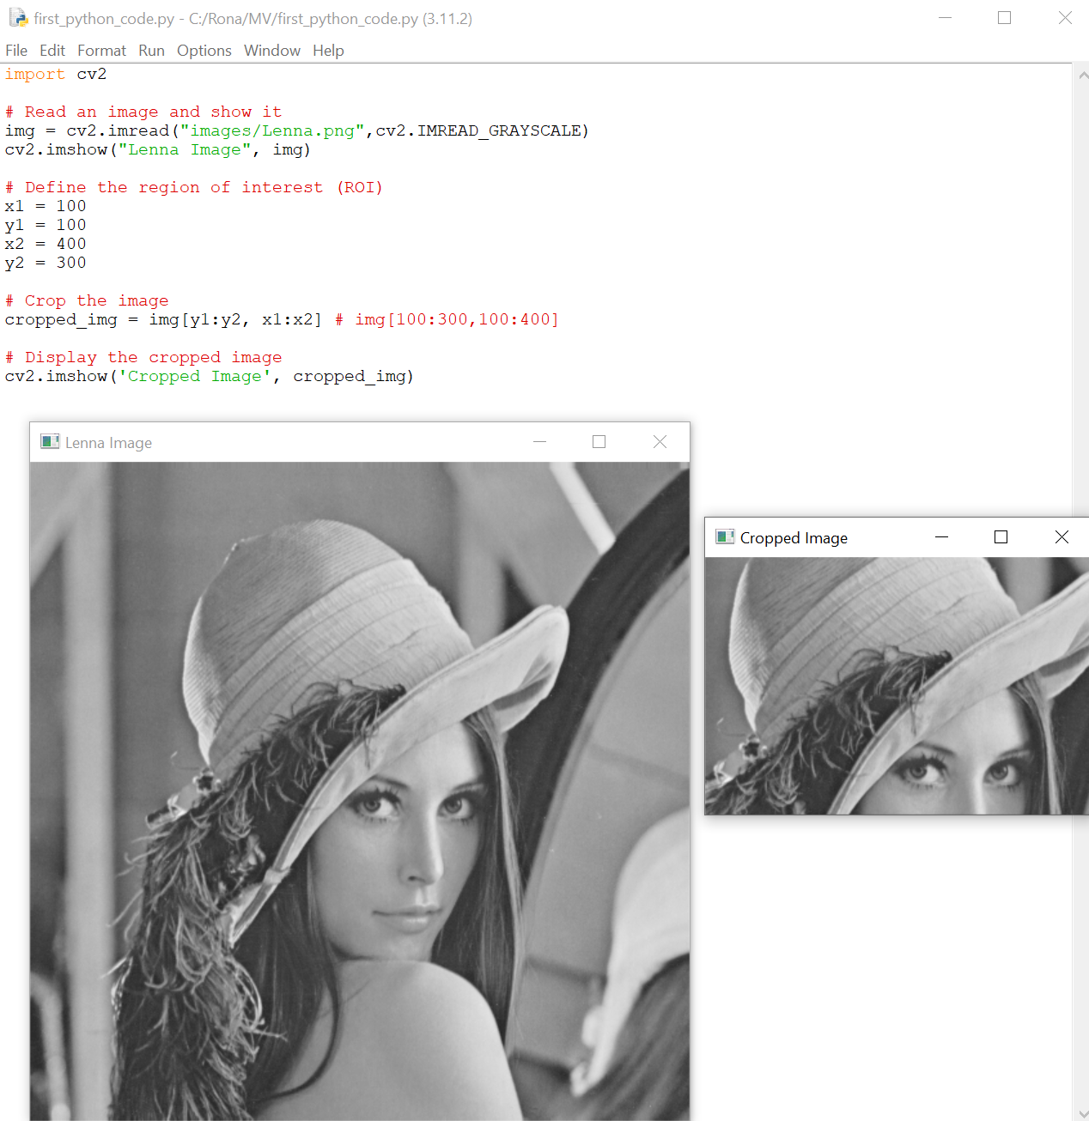
Basic image manipulation
Cropping

Slide 42
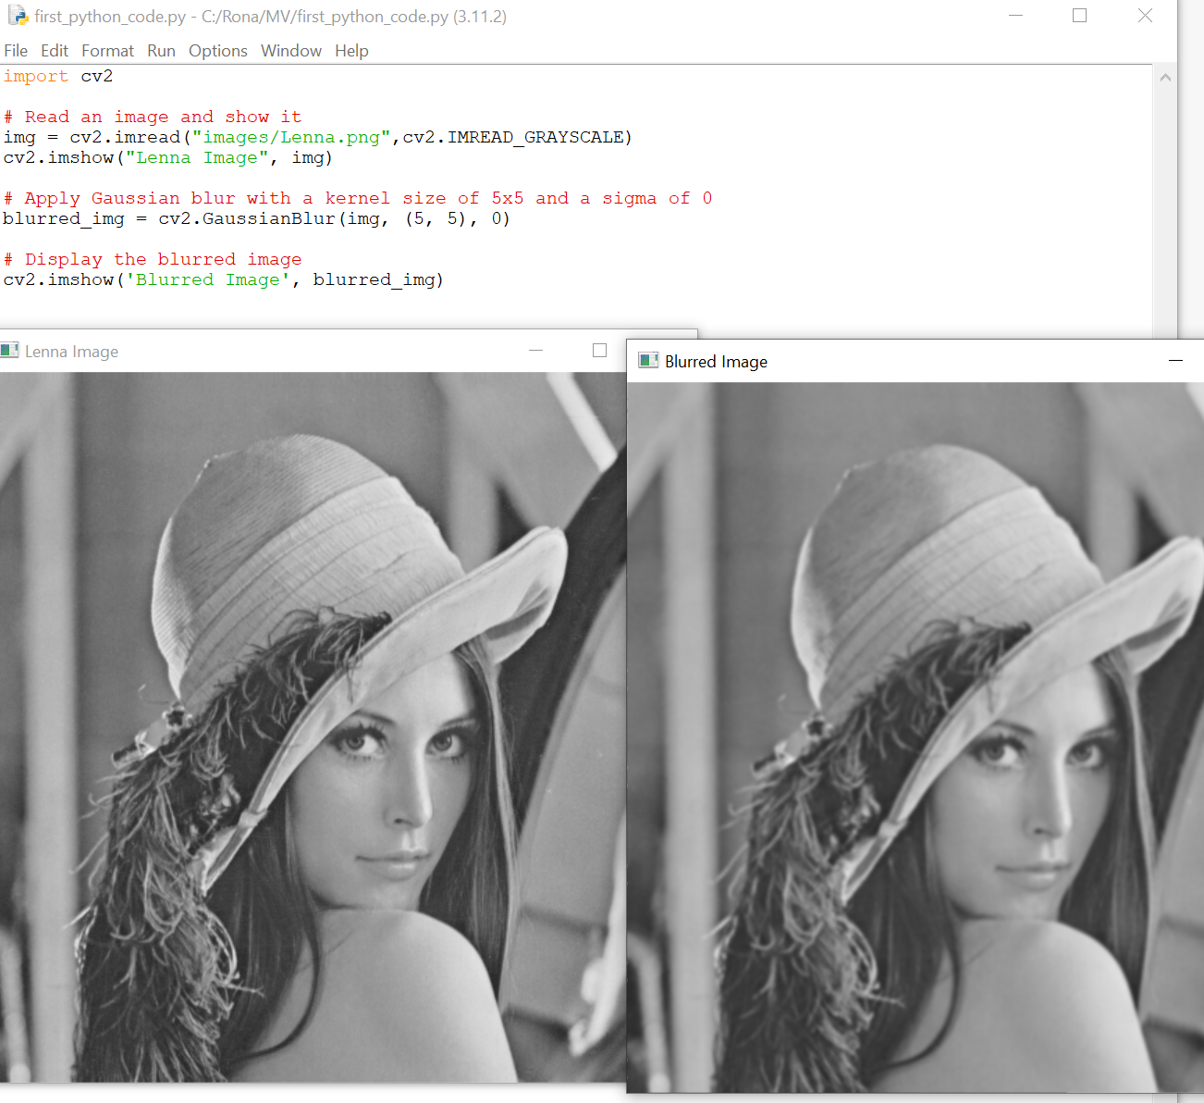
Image filtering
Blurring
Blurred images have less details
Blurred images look smoother
Blurring can be used for denoising

Slide 43
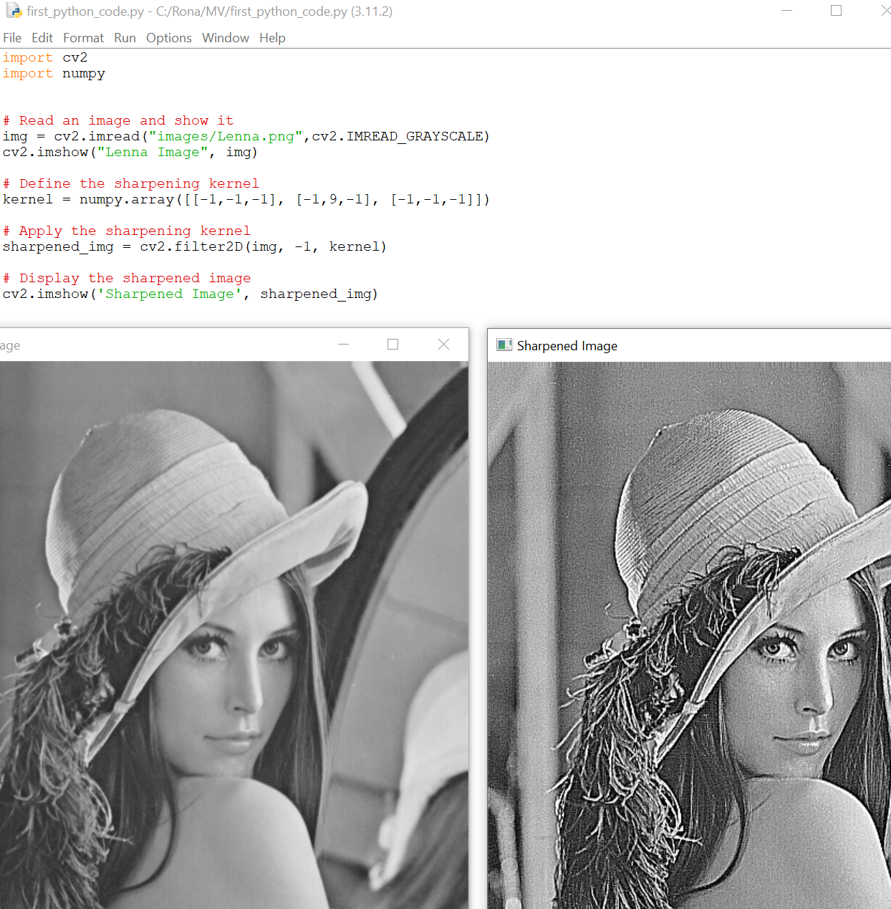
Image filtering
Sharpening

Slide 44
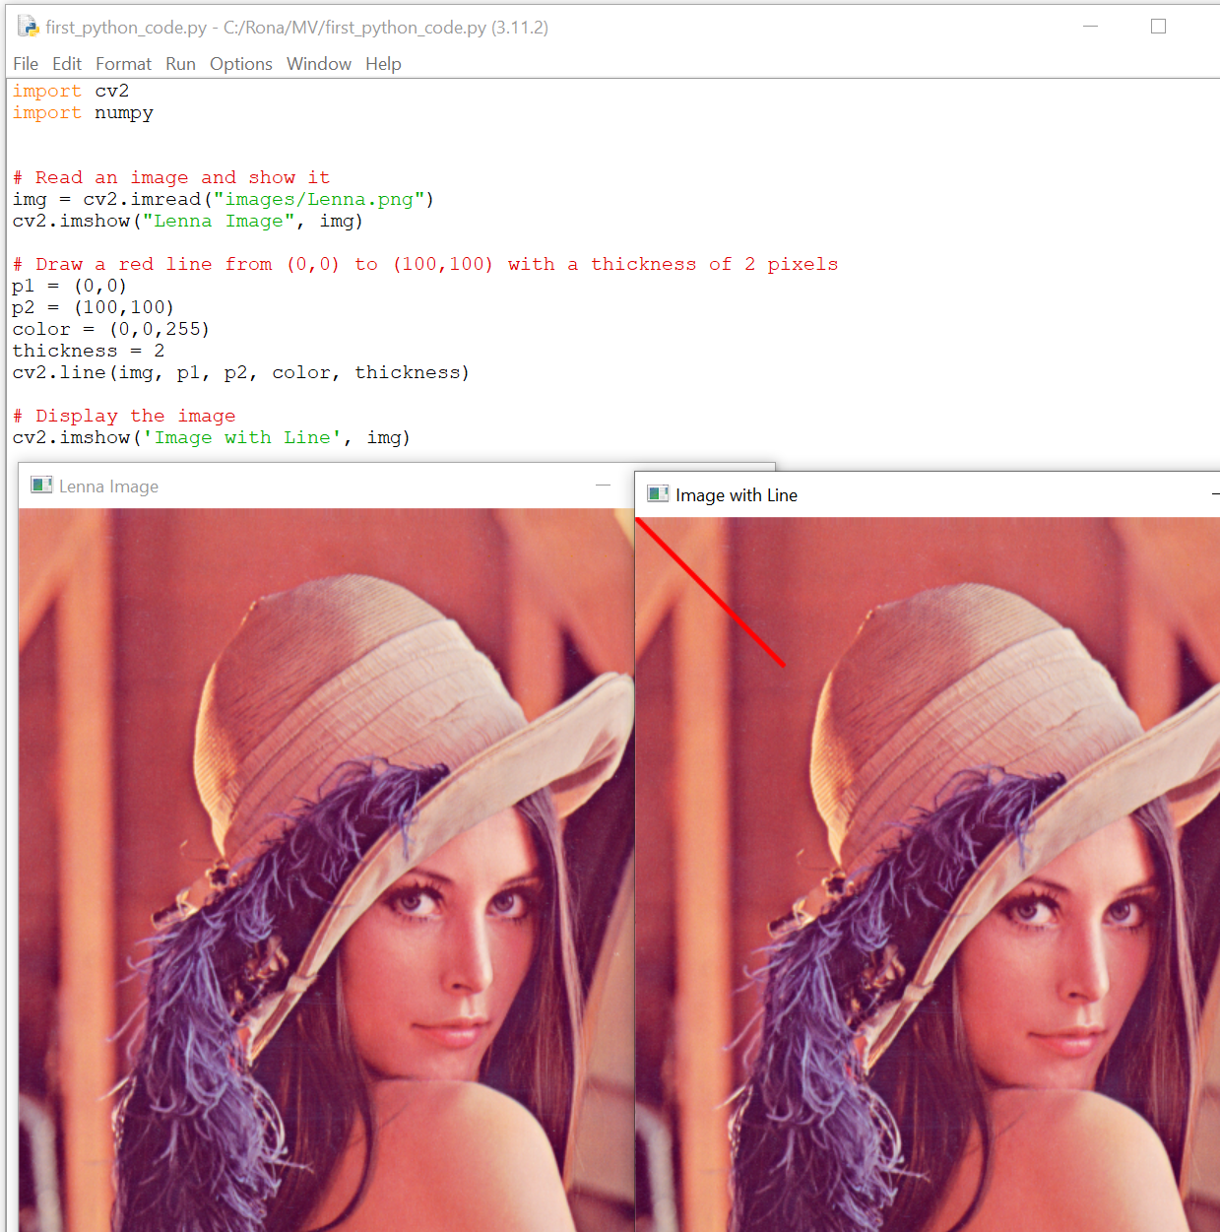
Drawing on images
Line

Slide 45
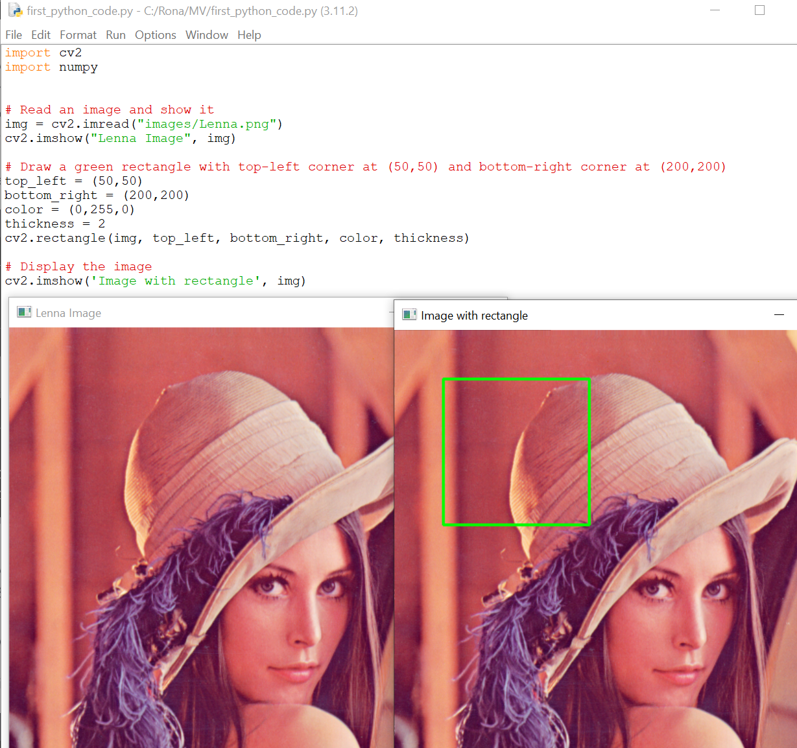
Drawing on images
Rectangle

Slide 46
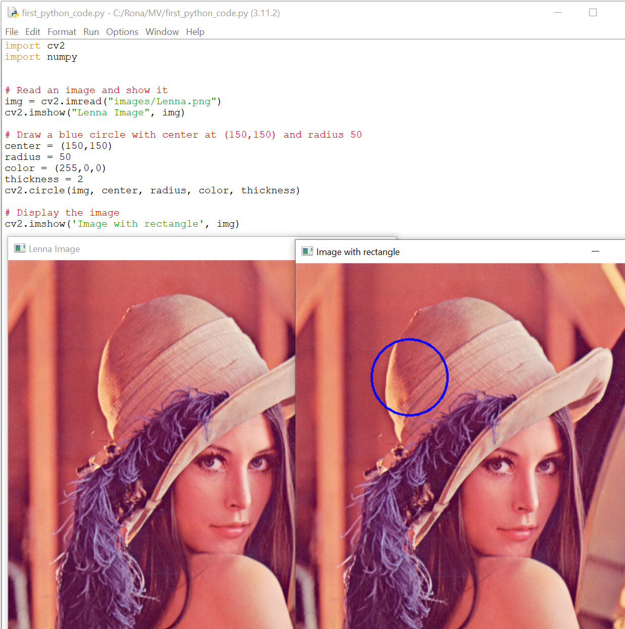
Drawing on images
Circle

Slide 47
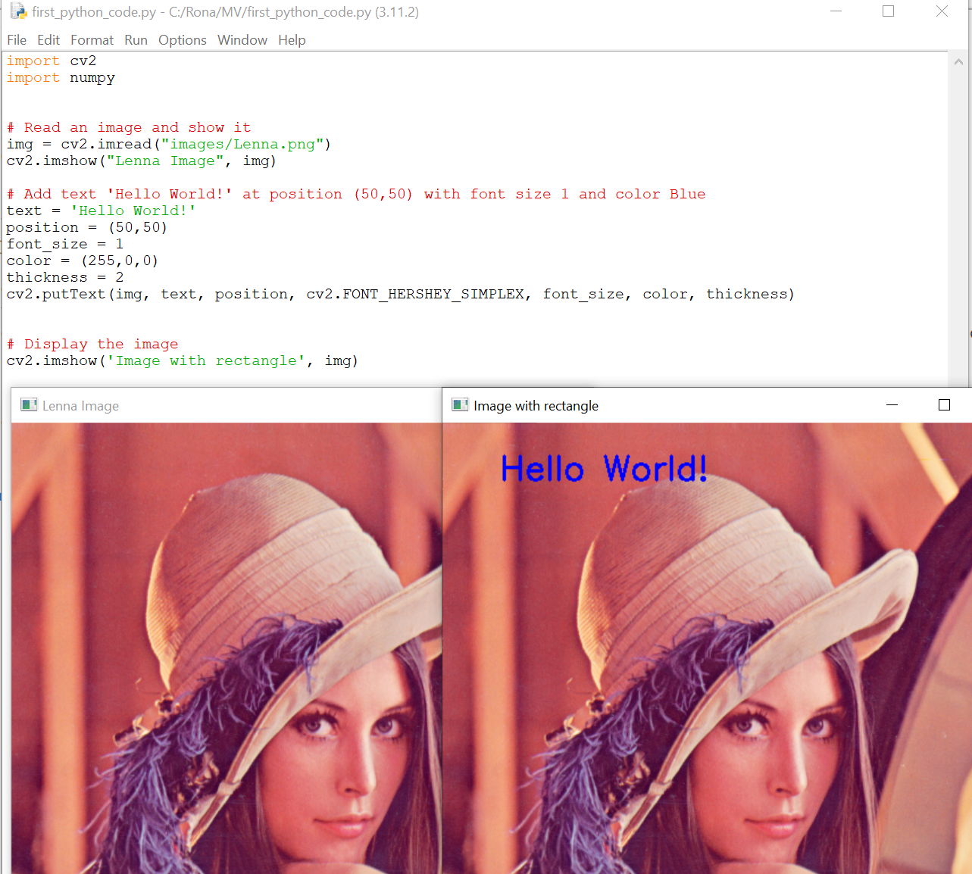
Drawing on images
Text

Slide 48
Object Detection

Slide 49
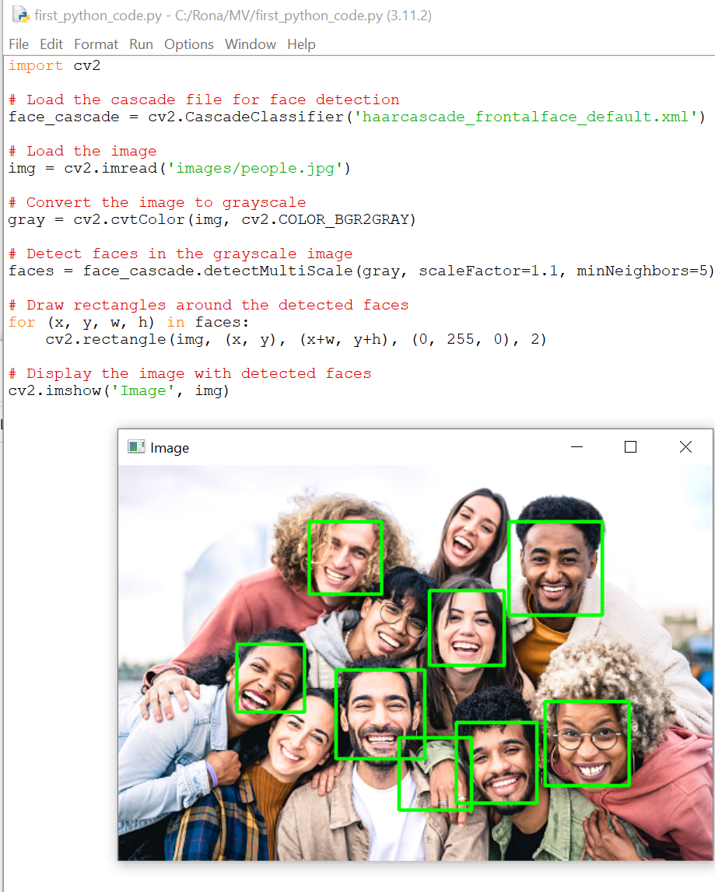
Object Detection
Face detection
The haarcascade_frontalface_default.xml file is a pre-trained
classifier provided by OpenCV for face detection.
https://github.com/opencv/opencv/tree/master/data/haarcascades
Haar classifier is a machine learning-based approach
for object detection in images and videos, and it is
implemented in the OpenCV library as a part of the cv2
Module.

Slide 50
More about Haar Classifier
The Haar classifier is based on the Haar wavelet transform, which can be used to extract features from an image. These features can then be used to train a classifier to detect objects in new images. The Haar classifier works by sliding a window over the input image and computing the Haar features for each window. The classifier then uses these features to classify each window as containing or not containing the object of interest.
Haar classifiers are commonly used for face detection and other object detection tasks. OpenCV provides pre-trained Haar classifiers for face, eye, and smile detection, among other things. These classifiers can be used directly or trained on new data to detect other objects.

Slide 51
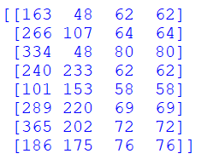
Detection results
print(type(faces))
Type: numpy array
print(faces.shape)
Shape: (8, 4) —> 8 people detected and for each one we have 4 values
print(faces)
Each detected face: [x1,y1, width, height]

Slide 52
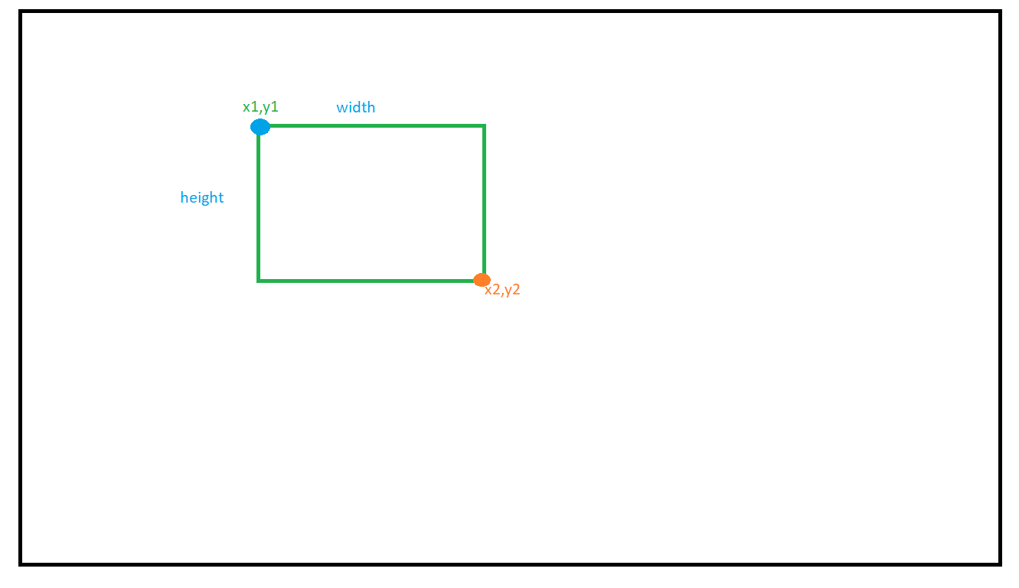
Finding the right values to draw rectangles

Slide 53
Finding the right values to draw rectangles
X1 = x
Y1 = y
X2 = x + width
Y2 = y + height

Slide 54
Python

Slide 55

Python in w3schools…
https://www.w3schools.com/python/default.asp

Slide 56
NumPy

Slide 57
Numpy
What is provided in the slides are a handful of concepts of NumPy. However, NumPy is a powerful library with many more features and functions. To learn more about NumPy, you can visit the official documentation at https://numpy.org/ or check out online resources such as https://www.w3schools.com/python/numpy/default.asp.

Slide 58
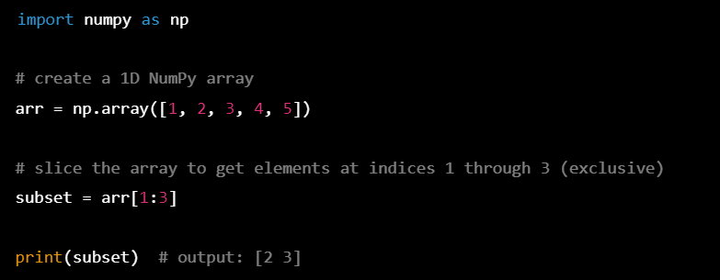
Numpy
Slice: Slicing is a way to extract a subset of elements from a NumPy array. Slicing is done using the [] operator and specifying the start and end indices of the desired subset. Here's an example:

Slide 59
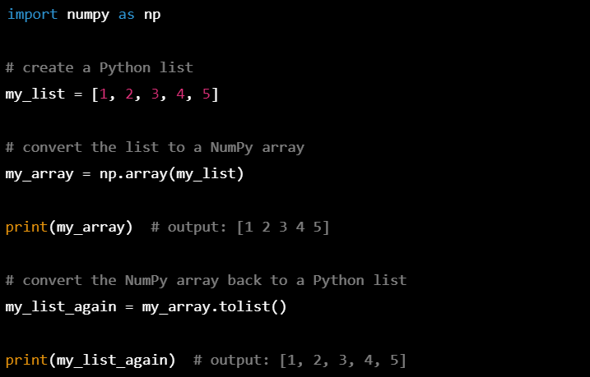
Numpy
List to numpy array and vice versa: You can convert a Python list to a NumPy array using the numpy.array() function, and vice versa using the tolist() method of a NumPy array. Here are some examples:

Slide 60
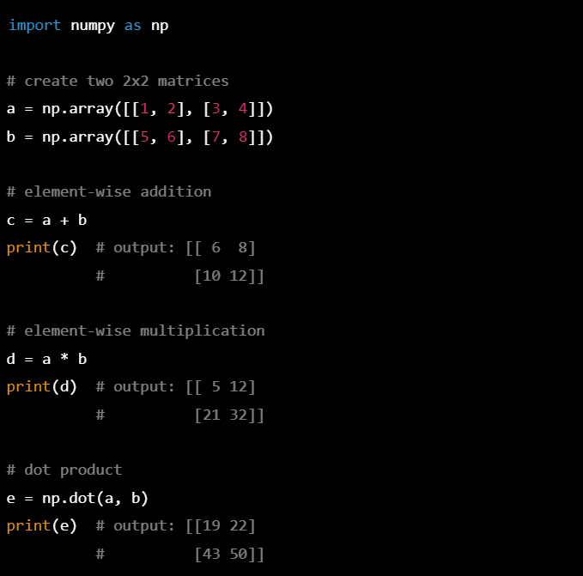
Numpy
Numpy operators on matrix: NumPy provides a wide range of mathematical and logical operators that can be used on NumPy arrays, including matrices. Here are some examples:

Slide 61

Numpy
Ones: numpy.ones() creates an array filled with ones of a specified shape. Here's an example:

Slide 62

Numpy
Arange: numpy.arange() creates an array of values with a specified start, stop, and step size. Here's an example:

Slide 63

Numpy
Slicing on multi-dimensional NumPy arrays: You can slice multi-dimensional NumPy arrays in a similar way to one-dimensional arrays. The syntax is [start1:stop1:step1, start2:stop2:step2, ...] where each start, stop, and step is optional and can be specified for each dimension. Here's an example:

Slide 64

Numpy
Flatten: numpy.flatten() is a method that returns a one-dimensional copy of a multi-dimensional NumPy array. Here's an example:

Slide 65
3D Body Pose Estimation
(Skeleton Detection)

Slide 66

3D Body Pose Estimation (Skeleton Detection)
What Is It?
3D body pose estimation (also known as skeleton detection) is the process of determining the position and orientation of a person's body parts in three-dimensional space from a given image or video. This involves using computer vision algorithms and machine learning techniques to identify key points (landmarks) on the person's body, such as joints and limbs, and then reconstructing the overall 3D pose based on the relative positions and movements of these points. This technology has many practical applications, including in sports analysis, virtual reality, and healthcare.
Example Link

Slide 67



Slide 68
How can we extract 3d points from 2d images?
Stereo Vision:
Capturing multiple images of a scene or object from different viewpoints (Monocular depth estimation)
Using stereo cameras
Deep Learning techniques: These methods use deep neural networks (mostly CNNs) to learn the mapping between the 2D image and its corresponding depth map. They are trained on large datasets of images and their ground-truth depth maps, and they learn to infer depth from various visual cues such as texture, shading, and perspective.
, ...

Slide 69
3D Body Pose Estimation (Skeleton Detection)
What Else Do We Need?
Mediapipe —> https://google.github.io/mediapipe/solutions/pose.html
Mediapipe is an open-source framework developed by Google that provides a collection of pre-built, customizable machine learning (ML) models and pipelines for a wide range of applications, including computer vision. It allows developers to easily build and deploy ML-based applications.
Note: Mediapipe is not the only option

Slide 70


3D Body Pose Estimation
Single Images

Slide 71

3D Body Pose Estimation
Video frames
Download sample video from here:
https://www.pexels.com/search/videos/dancing/

Slide 72

3D Body Pose Estimation
Video frames
Saving the result using cv2.VideoWriter

Slide 73

3D Body Pose Estimation
Real-time data (Camera)

Slide 74

3D Hand Pose Estimation

Slide 75
What You Should Do
Try to detect skeleton for multiple bodies in each image

Slide 76
OpenPose
OpenPose is an open-source software for real-time body, hands, and facial keypoint detection.
Link→ https://github.com/CMU-Perceptual-Computing-Lab/openpose
import cv2
# Load OpenPose model and its network parameters
net = cv2.dnn.readNetFromTensorflow("openpose/models/pose/body/pose_iter_584000.caffemodel",
"openpose/models/pose/body/pose_deploy_linevec_faster_4_stages.prototxt")
# Prepare sample image
image = cv2.imread("images/test.jpg")
.
.
.
# Set the input for the network
net.setInput(image)
.
.
.

Slide 77
Anaconda and Miniconda

Slide 78

Anaconda and Miniconda
Anaconda and Miniconda are both tools that help you manage Python packages and dependencies. Using them, you can have different python versions (each have their own set of packages and dependencies).
Anaconda is a more comprehensive tool that includes lots of pre-installed packages and tools for data science and scientific computing.
Miniconda is a smaller and more lightweight version of Anaconda. It only includes the essential components to manage packages and dependencies, and you have to install additional packages yourself. It gives you more control over what you install and use.

Slide 79
Anaconda and Miniconda
Download Anaconda -> https://www.anaconda.com/products/distribution
Download Miniconda -> https://docs.conda.io/en/latest/miniconda.html

Slide 80
Create environments and installing packages
1- Install miniconda/anaconda
2- Open anaconda prompt
3- Create env → conda create -n “environment name” python== “version”
ex) conda create -n arvr python==3.10.9
4- Activate the env → conda activate “environment name”
ex) conda activate arvr
5- Installing packages→ python -m pip install “package name”
ex) python -m pip install numpy
6- Install Visual Studio Code
7- Visual Studio Setting (install python related features and set the python interpreter)
8- Start Coding…

Slide 81
Body Tracking with Stereo Cameras

Slide 82




What are Stereo Cameras?
Stereo cameras are a type of camera system that uses two or more cameras to capture images of the same scene from different angles. By analyzing the differences between these images, we can calculate the distance to objects in the scene

Slide 83


Slide 84


Slide 85


Top View

Slide 86

ZED Camera
Homepage : https://www.stereolabs.com/

Slide 87
Body Tracking with ZED Camera
Homepage developer section: https://www.stereolabs.com/developers/
Bodytracking → Python

Slide 88

ZED Camera SDK Installation
Documents Link: https://www.stereolabs.com/docs/
Everything (Installation, body tracking setting,...) we need can be find under the link above.

Slide 89

ZED Camera SDK Installation
Recommended system specifications for using ZED: https://www.stereolabs.com/docs/installation/specifications/
If you want to use ZED you should come Here (We already did the setting).
For Windows installation follow this (https://www.stereolabs.com/docs/installation/windows/ ) Link.
Download ZED sdk as below…

Slide 90

ZED Camera SDK Installation
1- Install Zed SDK (CUDA will be installed as well)
If you already have CUDA installed make sure the version matches (Check the document).
If the CUDA version does not match uninstall it and let ZED install it.
2- Check zed
3- Install Python
ZED may have problem with some python versions that will need to do more setting to work properly
For example for me python3.10 had problem and I had to remove and install opengl python package. But it worked properly with python3.7.3.
4- For developers (us): Follow the document to install python api

Slide 91

ZED Python API Installation

Slide 92
How To Use ZED Body Tracking Example?
Find and open the code in vs code
Run the body tracker with the default setting (Live Stream)
Play a sample (downloaded) SVO file on the disk and explain it a little bit
Run the body tracker on a sample SVO file
Export key points as csv
Frame Rate
What else? → export your dancing as SVO using ZED

Slide 93


Slide 94


